Slide 1
GDOT Approach to
Wall Foundation Investigations
LRFD Methodology
Adebola Adelakun, E.I.T., MSCE

Slide 2
Presentation Outline
History
GDOT Approach
Phase 1 - Soil Parameters
Phase 2 - WFI Analysis
Report Recommendation

Slide 3
History
Allowable Stress Design (ASD) was used generally in the US for foundation design
Work began on developing Load and Resistance Factor Design (LRFD) in 1989
In 1994, AASHTO approved LRFD spec. for use

Slide 4
History Cont’d
In 2000, FHWA required all DOTs to design structures in LRFD for PE authorized projects let after October 1, 2007, or provide justification and a timeline
GDOT first developed an LRFD process for deep foundations, and subsequently a process for shallow foundations

Slide 5
GDOT Approach
Phase 1 - Foundation & Retained Soil Parameters
Phase 2 – WFI Analysis and Report
Wall Envelope
Geotechnical Investigation
Boring Logs
Soil Parameters
Foundation Design Data
Factored Bearing Resistance Analysis
Settlement Analysis
Differential Settlement Analysis
WFI Report

Slide 6
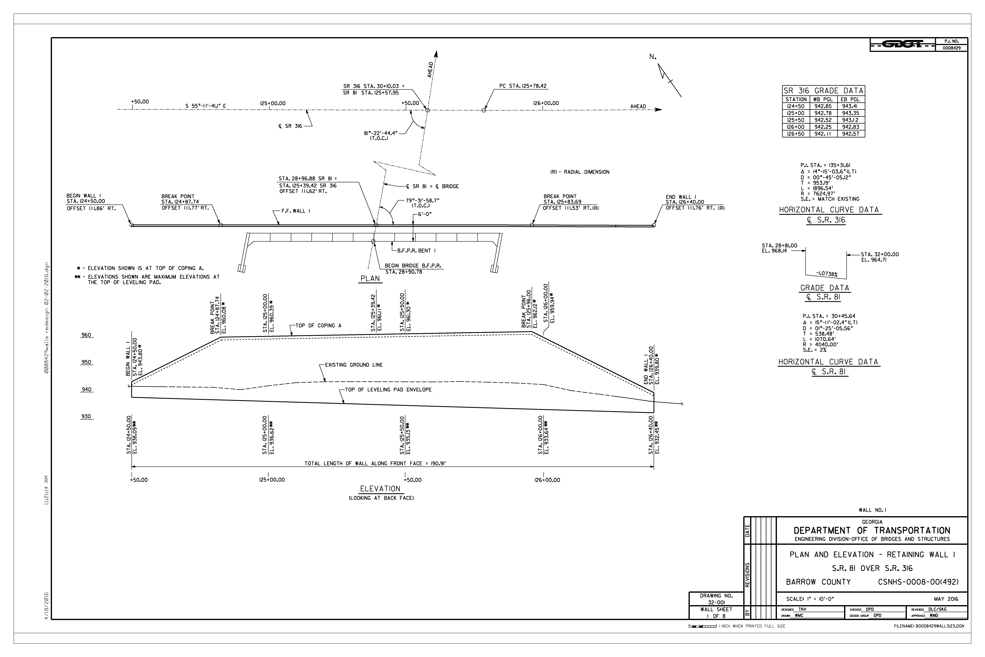
Phase 1 – Wall Envelope
The WFI process starts with receiving a Wall Envelope from the Bridge Office

Slide 7
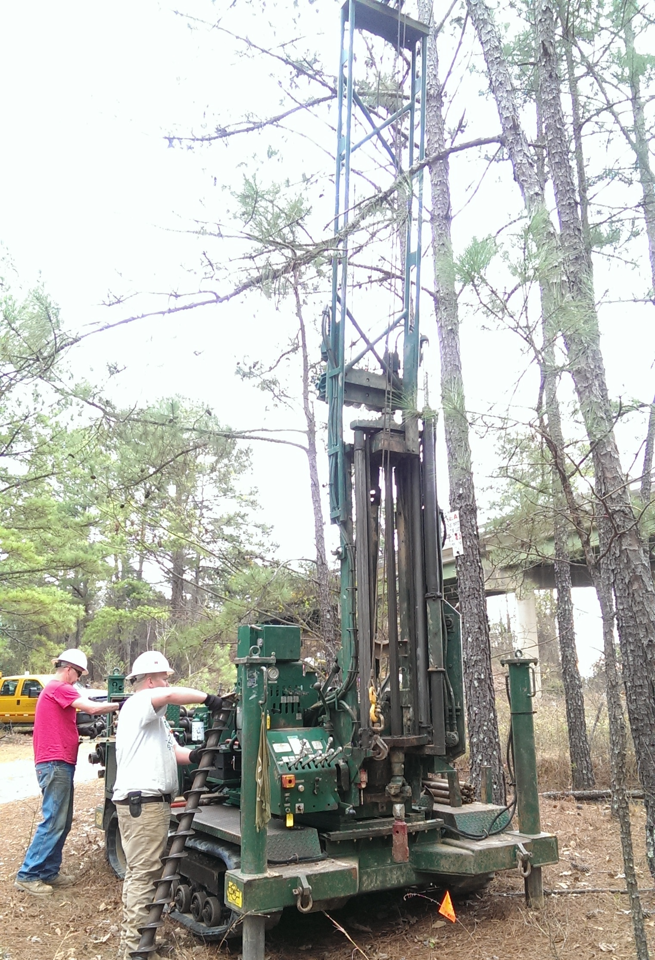
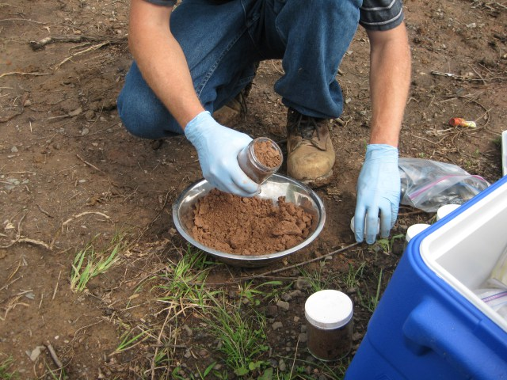
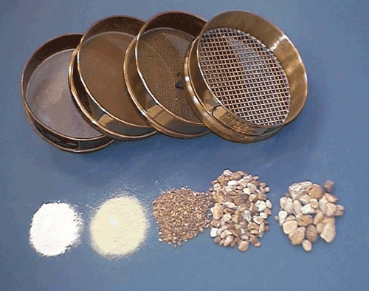
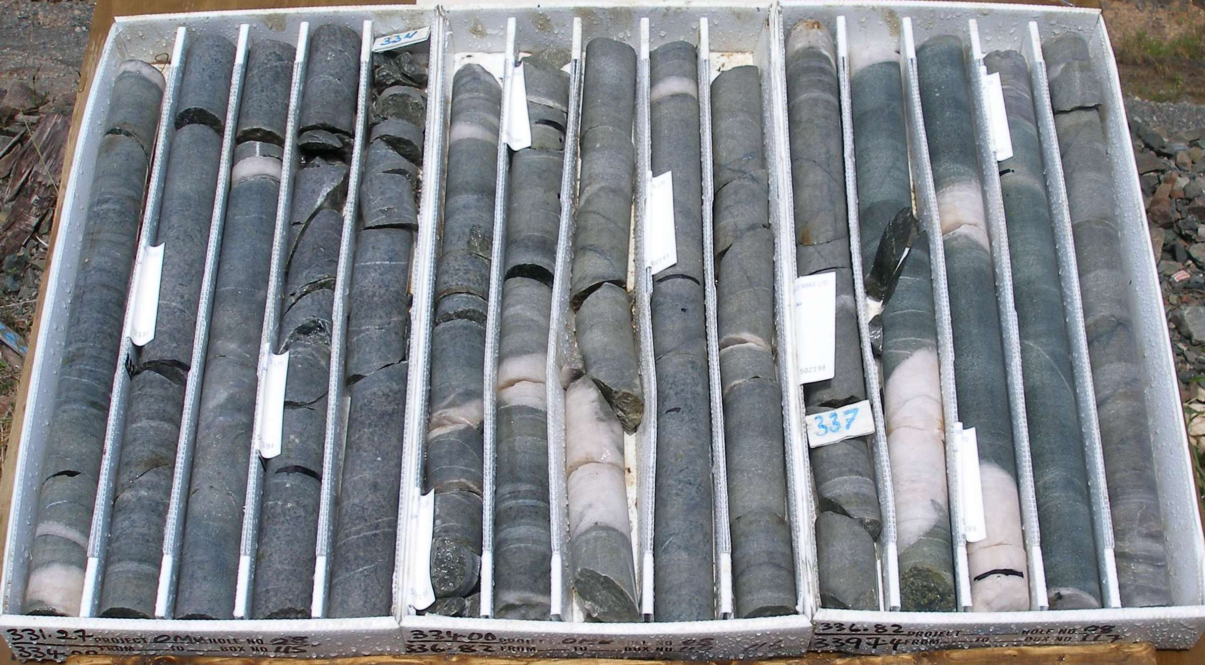
Phase 1 – Geotechnical Investigation
Drilling
Soil/Rock Sample Examination
Lab Tests

Slide 8
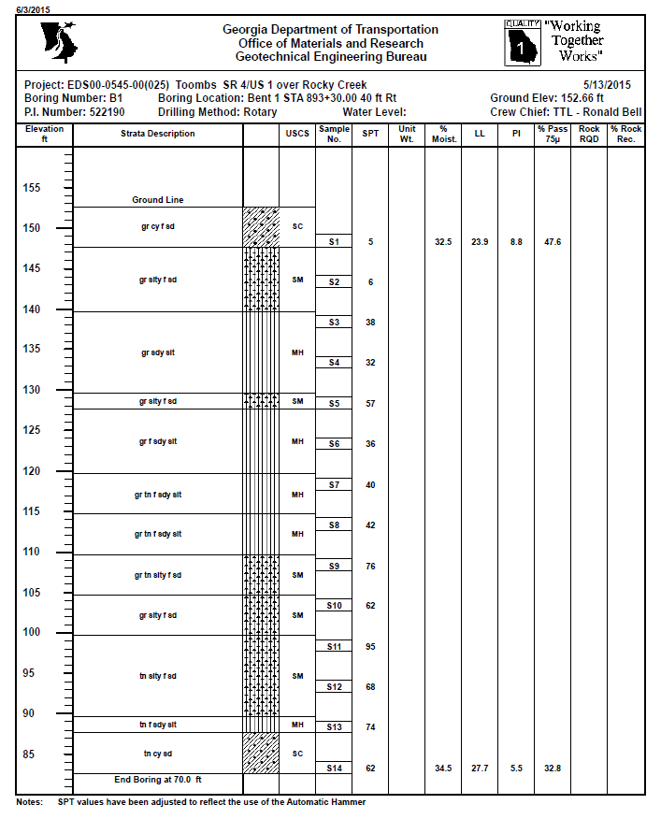
Phase 1 - Boring Logs

Slide 9
Phase 1 – Wall Soil Parameters
Foundation & Retained Soil Parameter Letter
We determine soil parameters based on the following:
  Geotechnical investigation/geology
  Finished boring logs
  Shallow Foundations LRFD Spreadsheet
A letter to the bridge office stating the following soil parameters (for foundation & retained soil):
  Soil Unit Weight
  Internal Friction Angle
  Cohesion (Usually Zero)

Slide 10
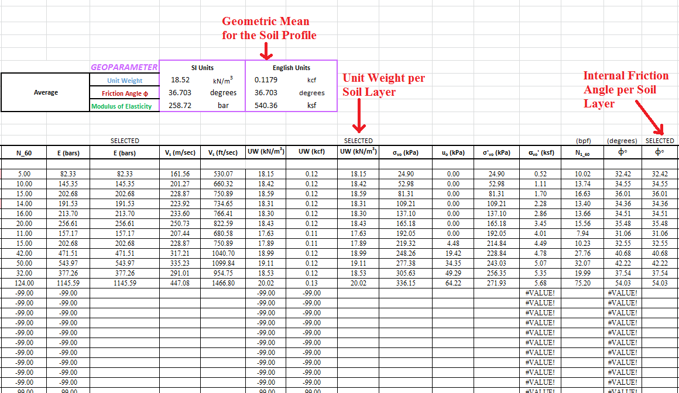
Soil Parameter Calculations

Slide 11
End of Phase 1

Slide 12
Phase 2

Slide 13
Phase 2 – WFI Analysis and Report
Foundation Design Data Letter received from Bridge Office contains:
Wall Heights
Base Width/Strap Lengths (MSE Walls)
Bearing Pressure (Strength and Service Limit States)
Effective Base Width/Strap Lengths (Strength and Service Limit States) – due to “eccentricity”

Slide 14
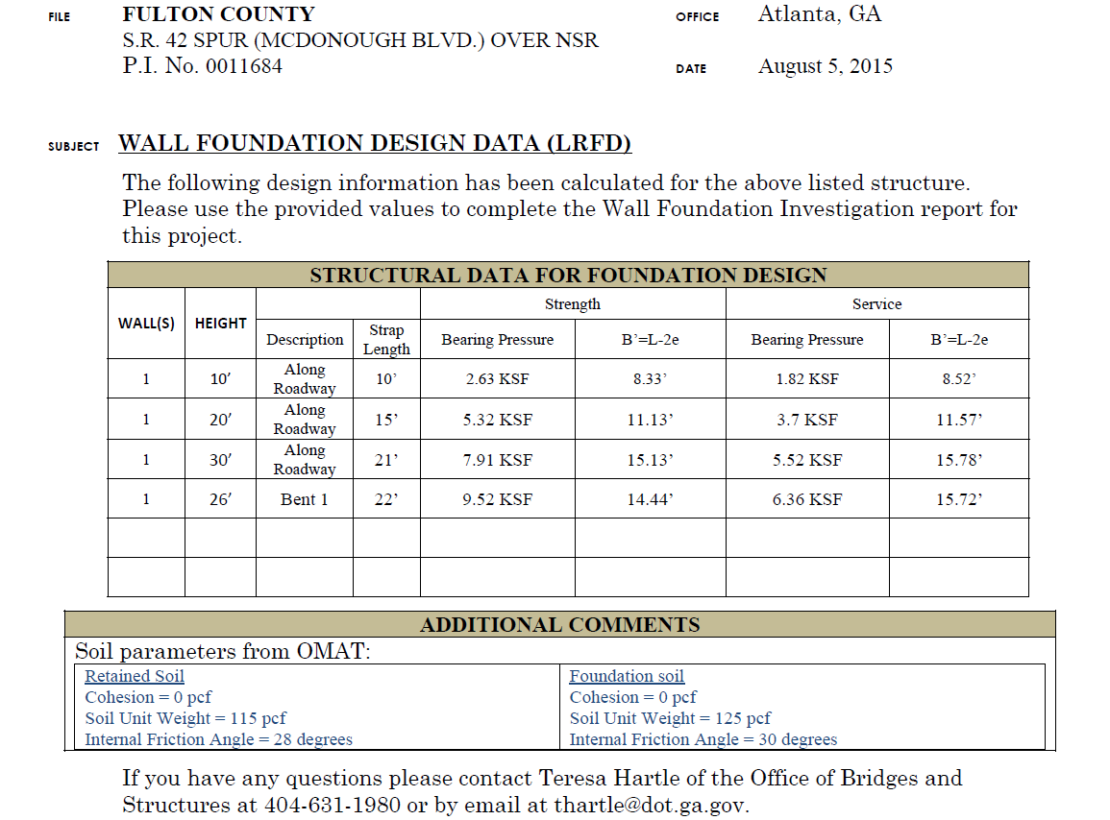

Slide 15
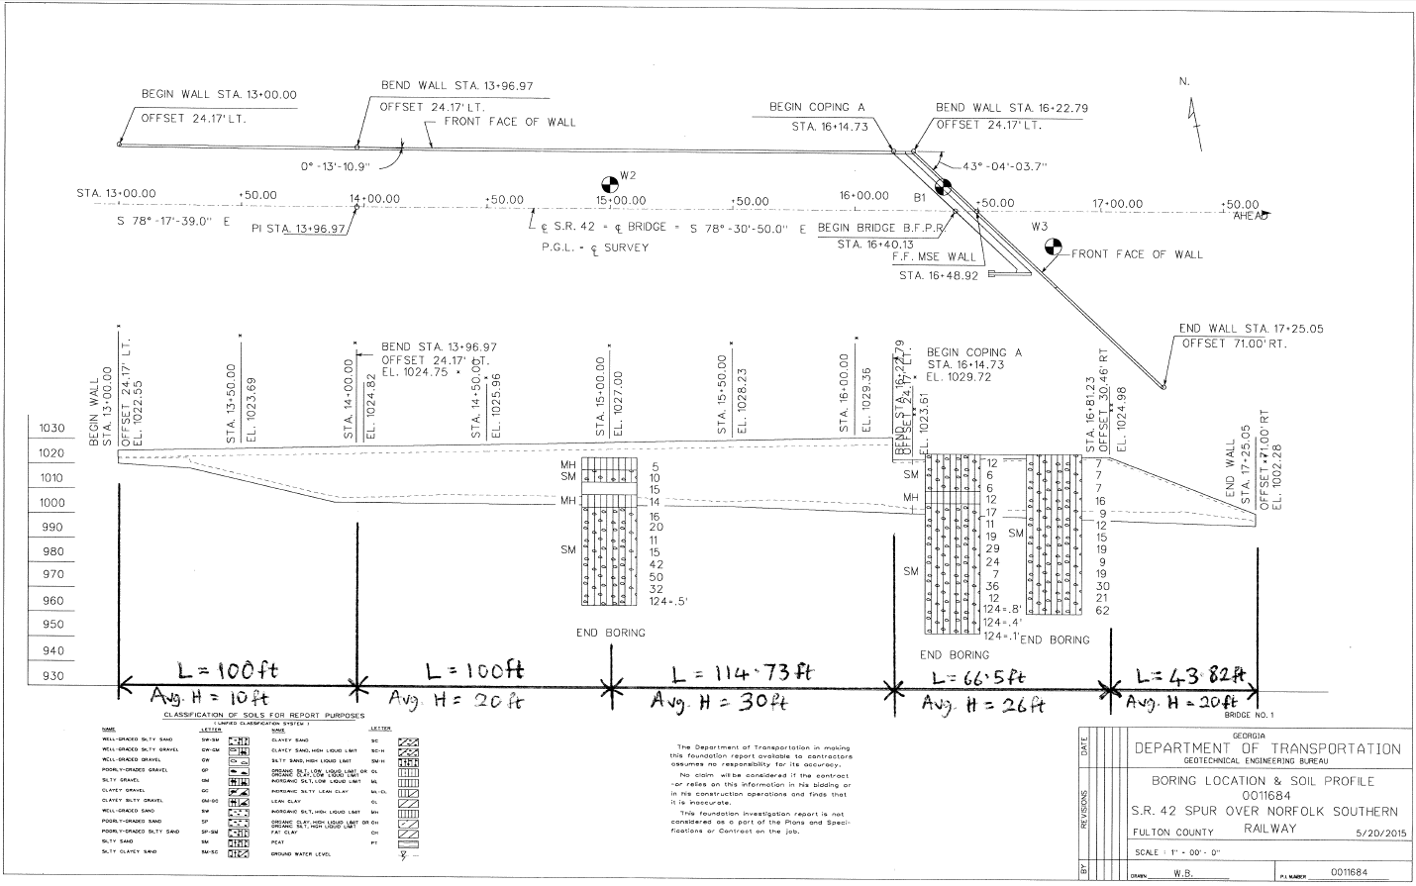
Divide Wall into Height Sections

Slide 16
“Input” Tab on Spreadsheet
Perform analysis per ‘wall height’ section
Enter:
Project info
GWT (boring log) and Energy Rating (from Driller)
Footing length (from wall envelope)
Footing width (from fdtn design data letter)
Specific settlement values (start w/ 0.5 in increments)
Footing input parameters
Boring log (when you have multiple logs, use log closest to current wall section being analyzed)

Slide 17
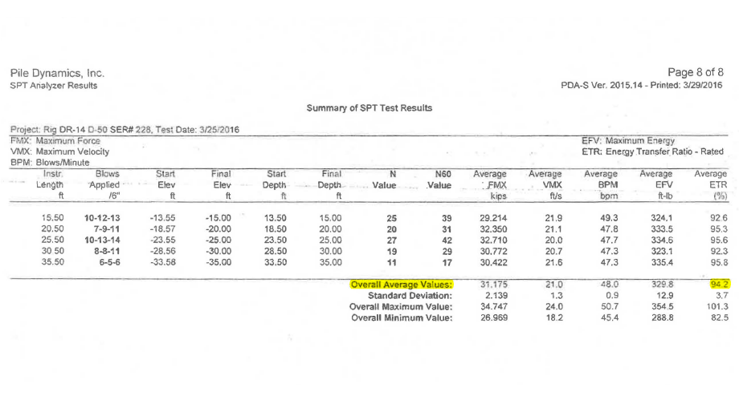
Sample Energy Rating Submittal

Slide 18
Footing Input Parameters
Embedment Depth, D_{f} (ft)
Footing Thickness, t (ft)
Layer Thickness, H (ft)
Elastic Modulus of Foundation Material, E_{fdtn} (ksf) – 600,000 for Concrete or 4000 for MSE Wall Backfill

Slide 19
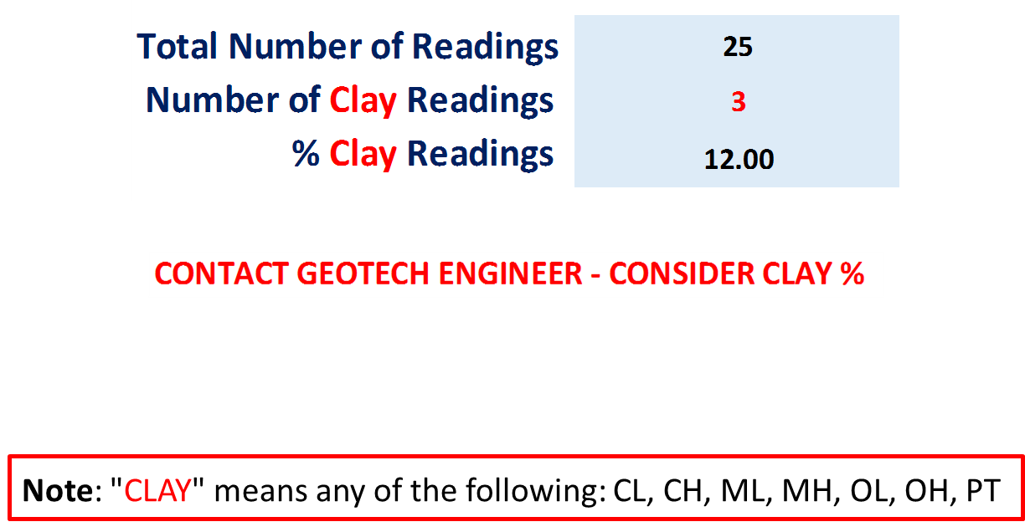
Clay Soils

Slide 20
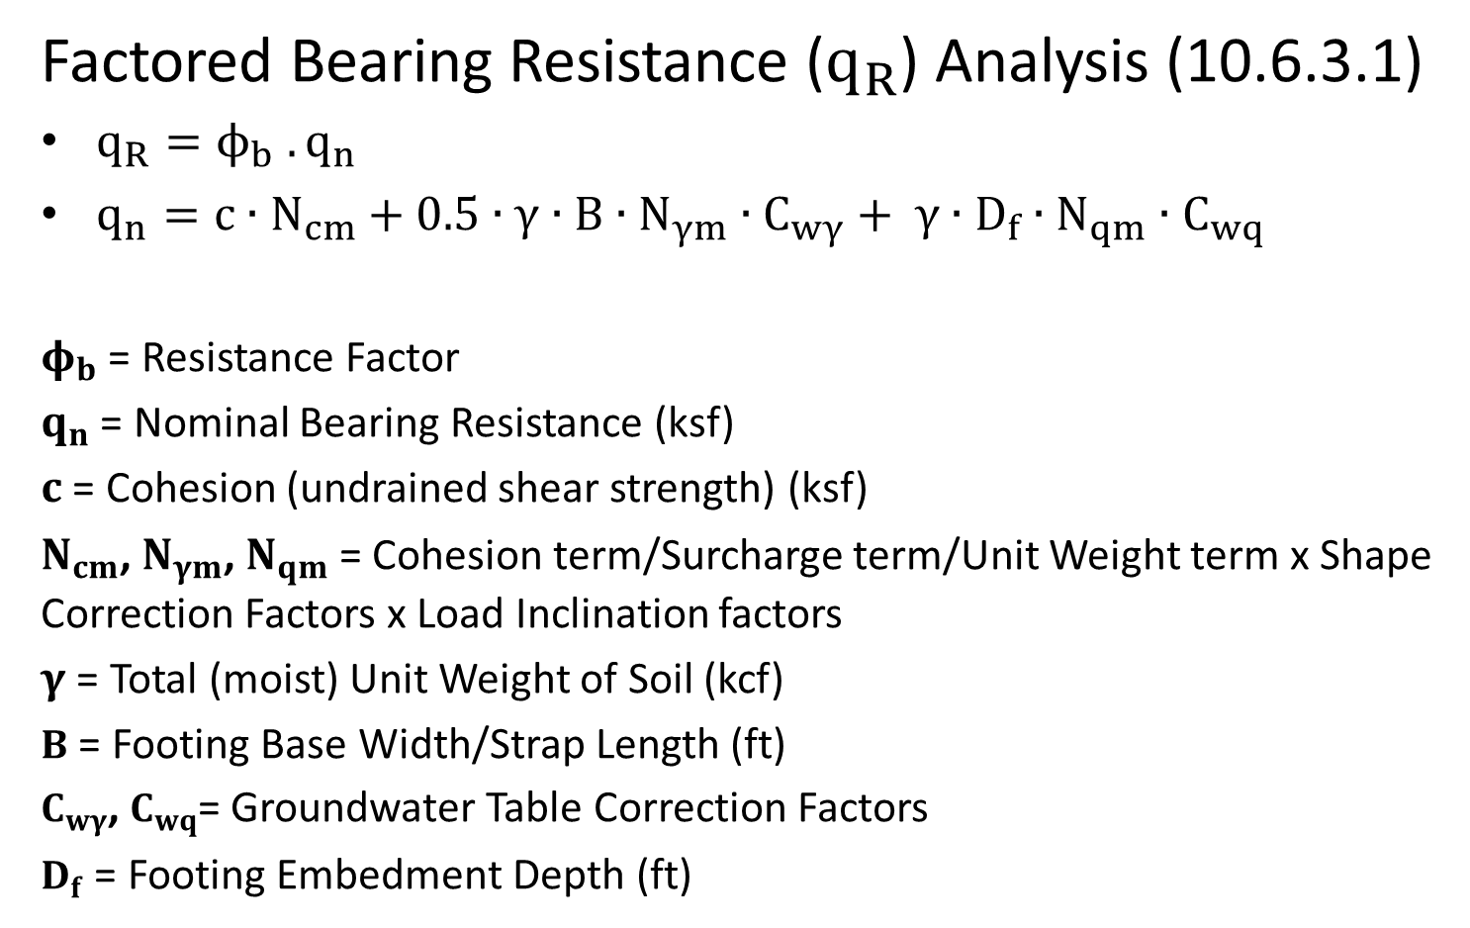
Phase 2 – WFI Analysis and Report
Factored Bearing Resistance ($q_{R}$) Analysis (10.6.3.1)
$q_{R}=ϕ_{b} . q_{n}$
$q_{n}=c∙N_{cm}+0.5∙γ∙B∙N_{γm}∙C_{wγ}+ γ∙D_{f}∙N_{qm}∙C_{wq}$
$φ_{b}$ = Resistance Factor
$q_{n}$ = Nominal Bearing Resistance (ksf)
$c$ = Cohesion (undrained shear strength) (ksf)
$N_{cm}$, $N_{γm}$, $N_{qm}$ = Cohesion term/Surcharge term/Unit Weight term x Shape Correction Factors x Load Inclination factors
$γ$ = Total (moist) Unit Weight of Soil (kcf)
$B$ = Footing Base Width/Strap Length (ft)
$C_{wγ}$, $C_{wq}$= Groundwater Table Correction Factors
$D_{f}$ = Footing Embedment Depth (ft)

Slide 21
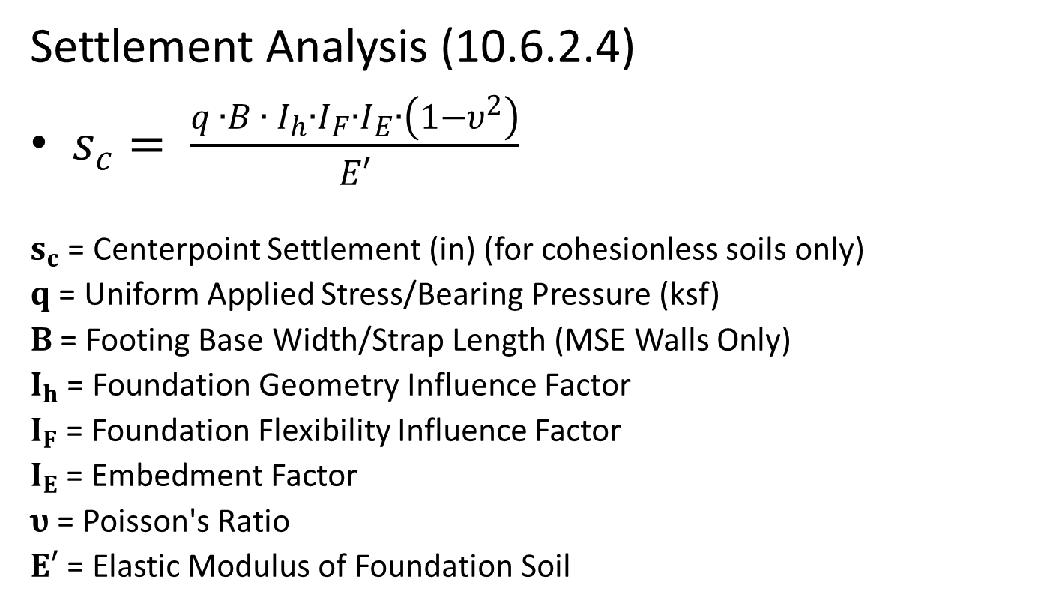
Phase 2 – WFI Analysis and Report
Settlement Analysis (10.6.2.4)
$s_{c}= \frac{q ∙B ∙ I_{h}∙I_{F}∙I_{E}∙\left(1−υ^{2}\right)}{E′}$
$s_{c}$ = Centerpoint Settlement (in) (for cohesionless soils only)
$q$ = Uniform Applied Stress/Bearing Pressure (ksf)
$B$ = Footing Base Width/Strap Length (MSE Walls Only)
$I_{h}$ = Foundation Geometry Influence Factor
$I_{F}$ = Foundation Flexibility Influence Factor
$I_{E}$ = Embedment Factor
$υ$ = Poisson's Ratio
$E′$ = Elastic Modulus of Foundation Soil

Slide 22
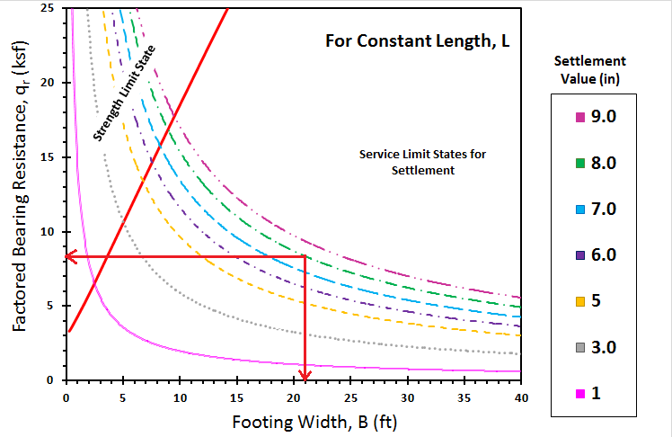
Output
The 30 feet high Wall Section has a 21 feet Footing Width (Strap Length)
The bearing pressure (strength) for this wall section is 7.91 ksf
After analysis, the graph is showing that if we control for 8 inches of settlement, we will get 8.06 ksf in bearing resistance (> 7.91, so its ok)

Slide 23
Phase 2 – WFI Analysis and Report
Differential Settlement Analysis (C11.10.4.1-1 & C11.6.2.2)
The ratio of the difference in settlement of adjacent wall sections and their horizontal distance
Purpose is to avoid overstressing the wall - a section of wall could potentially cause other sections or the entire wall system to fail
Limit for MSE Walls is 1/100 (<0.01)
Limit for Conventional Retaining walls is 1/1000 (<0.001)

Slide 24
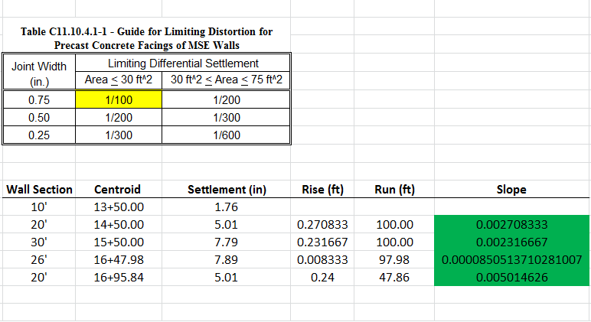
Differential Settlement Check

Slide 25
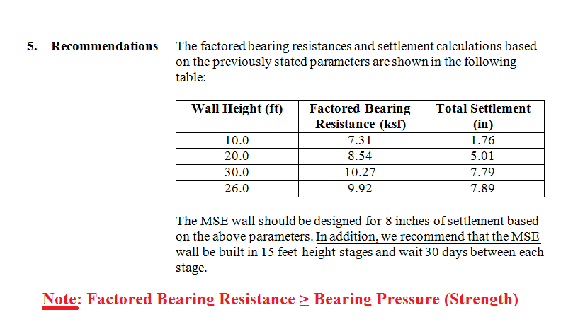
WFI Report Recommendation

Slide 26
The End
Any Questions?

